Slide 1
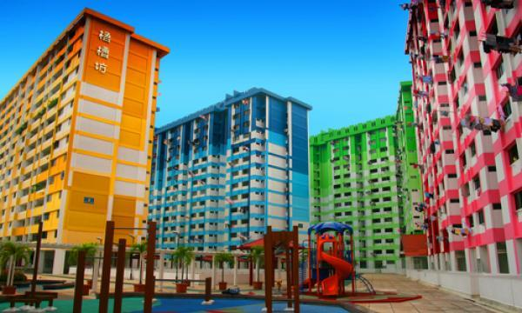
Singapore Flats: Deal or No Deal
By: Jia Yi C P7337992

Slide 2
Overview RAW: Data sets
MRT Coordinates in pixels.csv (data extracted from TownMap pictures for Nov 2018 SBF to see location of MRT per TownMap. This data will then be added to townmap_xy.csv to allow us to see distance between nearest MRT and the flats through a series of codes in Nearest Distance between blocks.ipynb)
Townmap Raw and Parsed from HTML/townmap_xy.csv ( location of the HDB blocks scrapped from HDB website per TownMap for Nov 2018 SBF)
unitsDetails.csv ( scrapped from HDB website for information about the flats for Nov 2018 SBF)
Attention: 1,2,3 are merged to become “Merged_unitsDetails_DistToMrt.csv” which we frequently use later on. The 3 are merged in the notebook : Merged unitDetails_shortestDist.ipynb)
Number of Applications Received for 3-room and bigger flats as at 19 Nov 2018.csv ( grabbed straight from HDB website)
median-resale-pricesby-town-and-flat-type.csv (from data.gov.sg website)
TownMaps (22 pictures crawled from HDB website)
MP14_PLNG_AREA_NO_SEA_PL.json( original was KML converted to JSON. For drawing interactive Singapore Map)

Slide 3
OVERVIEW : UrLs of Data Sets
https://data.gov.sg/dataset/median-resale-prices-for-registered-applications-by-town-and-flat-type?resource_id=a5ddfc4d-0e43-4bfe-8f51-e504e1365e27
https://services2.hdb.gov.sg/webapp/BP13AWFlatAvail/BP13EBSFlatSearch?Town=Kallang+%2F+Whampoa&Flat_Type=SBF&selectedTown=Kallang+%2F+Whampoa&Flat=4-Room&ethnic=Y&ViewOption=A&Block=26A&DesType=A&EthnicA=Y&EthnicM=&EthnicC=&EthnicO=&numSPR=&dteBallot=201811&Neighbourhood=N4&Contract=C21&projName=&BonusFlats1=N&searchDetails=&brochure=true (click on all the tabs to crawl the rest of the data)
https://services2.hdb.gov.sg/webapp/BP13BTOENQWeb/AR_Nov2018_SBF?strSystem=SBF
https://data.gov.sg/dataset/master-plan-2014-planning-area-boundary-no-sea

Slide 4
final datasets (derived & raw datasets) that are used
MP14_PLNG_AREA_NO_SEA_PL.json ( original was KML converted to JSON. For drawing interactive Singapore Map)
https://data.gov.sg/dataset/master-plan-2014-planning-area-boundary-no-sea
median-resale-pricesby-town-and-flat-type.csv (from data.gov.sg website)
https://data.gov.sg/dataset/median-resale-prices-for-registered-applications-by-town-and-flat-type?resource_id=a5ddfc4d-0e43-4bfe-8f51-e504e1365e27
7176 records
Columns includes: quarter , town , flat_type , price
Merged_unitsDetails_DistToMrt.csv
https://services2.hdb.gov.sg/webapp/BP13AWFlatAvail/BP13EBSFlatSearch?Town=Kallang+%2F+Whampoa&Flat_Type=SBF&selectedTown=Kallang+%2F+Whampoa&Flat=4-Room&ethnic=Y&ViewOption=A&Block=26A&DesType=A&EthnicA=Y&EthnicM=&EthnicC=&EthnicO=&numSPR=&dteBallot=201811&Neighbourhood=N4&Contract=C21&projName=&BonusFlats1=N&searchDetails=&brochure=true
1221 records
Columns includes : town, rmType, blk, unitNum, level, sqm, sellingPrice, Color, repurchasedFlat, Leaselessthan60yrs, street, probablecompletiondate, deliveryPossessiondate, leaseCommencementdate availableEthnicQuotaMl, availableEthnicQuotaCh, availableEthnicQuotaIn, lastUpdate, NearestMrt , DistToMrt, blkX, blkY
Number of Applications Received for 3-room and bigger flats as at 19 Nov 2018.csv
https://services2.hdb.gov.sg/webapp/BP13BTOENQWeb/AR_Nov2018_SBF?strSystem=SBF
65 records
Columns includes : town , FlatType , No_of_Units , Number_of_applicants , Rate_Non_Elderly_First_timers , Rate_Non_Elderly_Second_timers , Rate_Non_Elderly_Overall , Mature_Estates

Slide 5
context
Young Chinese couple was looking to buy “almost immediate flats” (BTO is out of the picture due to time constraint).
Decided to look at the Nov 2018 Sales of Balance Flats(SBF)
Only keen on 4 or 5-Room flats
Don’t like to live too low level floors (couple accepts floor level >=5) , but prefers level 10 and above.
Wishes to find out which flat is most value for money
Accessible to public transport as the couple do not own vehicles. (**prioritize this over the price)
Don’t like old flats (“old” is subjective)
Also keen on looking out for interesting trends that is unexpected and find out more about their chances of getting a suitable flat.

Slide 6
Assumptions
Scrapped data gathers only flats that CHINESE can buy because the couple is a Chinese couple
Assumes budget of couple is $500k, but looking at flats between $300k to $400k mainly.
The slides may be making assumptions in earlier parts but by the end will either prove or disprove arguments proposed earlier.
Scrapped data suggests Nov 2018 only has 22 towns participating in the SBF for those flats Chinese are eligible for.
“Distance from MRT” in our context also means “Distance to the Nearest MRT station”
Distance within 2 bus stops away from MRT are considered walkable distance.
Assumes 1 Busstop is approx. 450m – 550m.

Slide 7
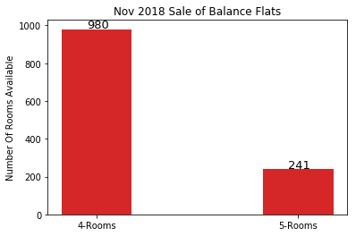
4-Room and 5-Room Flats Available in NOV 2018
It appears that there are more 4-Rooms than 5-Rooms
Sales of Balance Flats(SBF) in the market
4-Room has 980 while 5-Rooms have 241 flats
Speculate that more people can have better chance of
getting more affordable flats (4-Rooms are generally cheaper)
Plot1 : Count vs Room Type

Slide 8
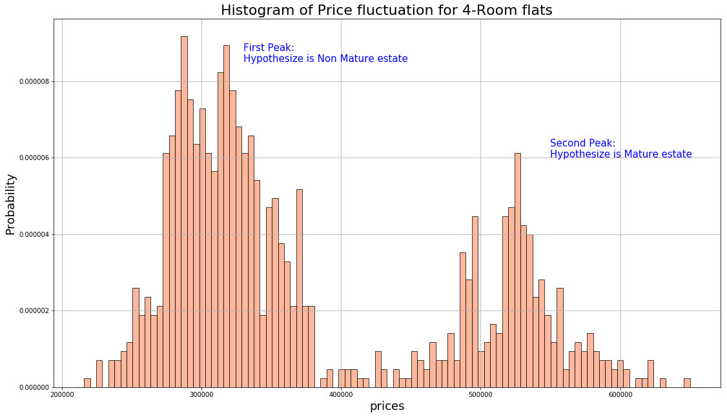
Seeing trends for prices in 4-Room in SBF Nov2018
For probability histogram over Prices,
2 peaks
Probable Non Mature and Mature Estates
Hypothesis: Price of Mature Estates
more expensive than Non Mature Estates
To be confirmed
Plot 2a : Probability graph of 4-Room over Price

Slide 9
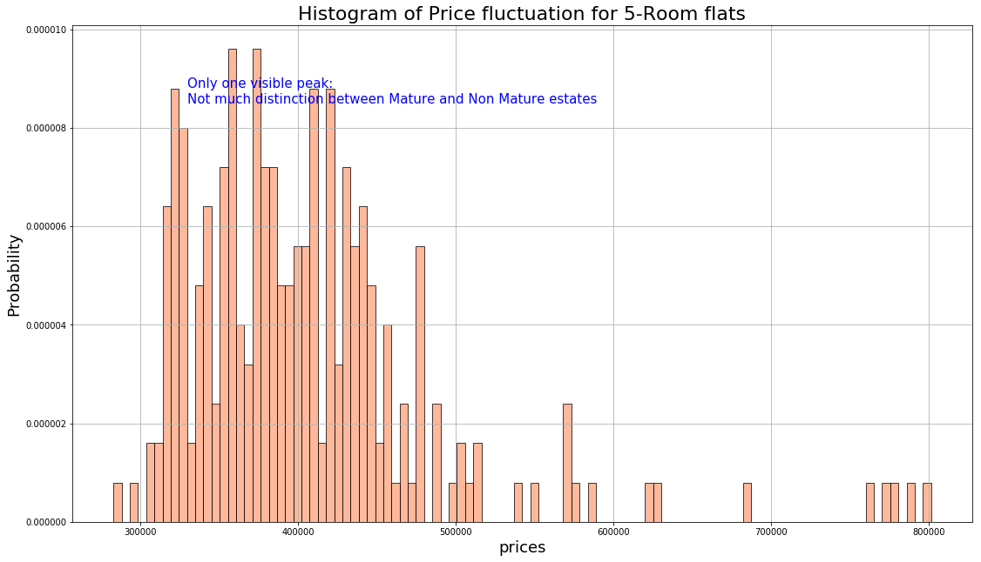
Seeing trends for prices in 5-Room in SBF Nov2018
For probability histogram over Prices,
1 peak visible
Hypothesis: Price of Mature Estates
is similar to Non Mature Estates
for 5-Rooms
To be confirmed
Plot 2b : Probability graph of 5-Room over Price

Slide 10
Spatial View: Where are the NOV 2018 SBF flats?
Plot 3: Interactive Map of where are these available SBF Nov 2018 flats (those with polygons only)

Slide 11
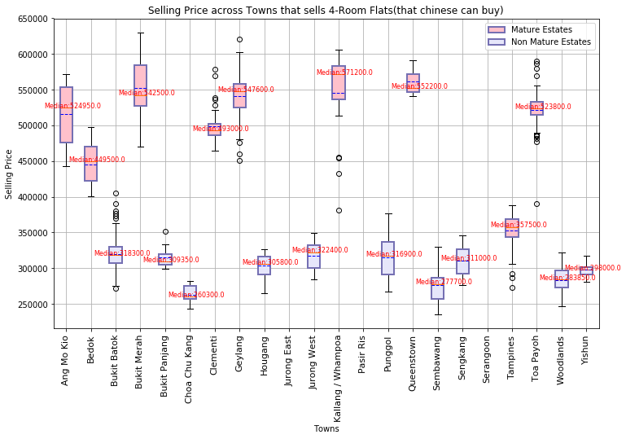
diff in prices between Mature and Non Mature in 4-Rm
Most of Mature Estates flats are more
expensive than Non Mature Estates
Surprisingly, the exceptional case is
Tampines, for 4-Room Flats. This means
The 4-Room flats in Tampines is quite
a GOOD DEAL!
Flats in Choa Chu Kang have small spread
and are the cheapest among the other towns.
Good deal.
Flats in Sembawang contains the cheapest,
but spread is quite large. Still Good deal overall
Let’s look deeper into individual units
Plot 4a : Boxplot of Selling Price over Towns

Slide 12
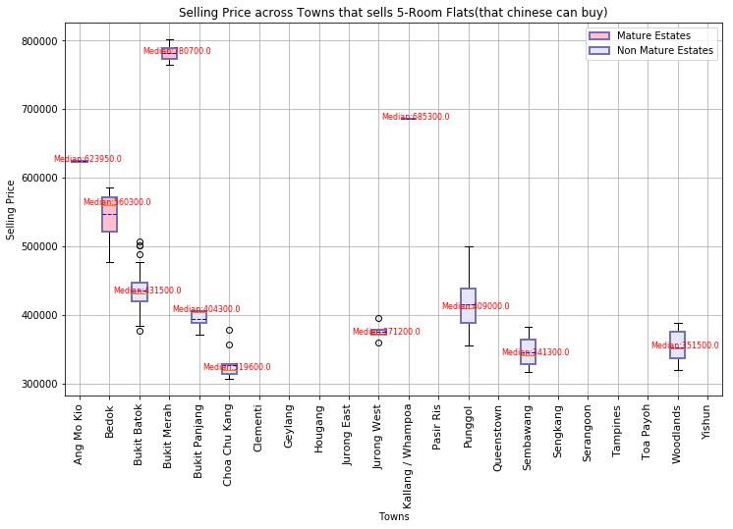
diff in prices between Mature and Non Mature in 5-Rm
Most of Mature Estates flats are more
expensive than Non Mature Estates
Previous hypothesis earlier was wrong about
1 peak means the prices are similar for diff estates
for 5-room flats
Flats in Choa Chu Kang are the cheapest
among the other towns. It only has few outliers.
Still Good Deal!
Flats in Bukit Merah is too expensive, bad deal.
For a Mature estate, Bedok price is quite close
to the non Mature town eg: Bukit Batok.
Acceptable deal!
Let’s look deeper into individual units
Plot 4b : Boxplot of Selling Price over Towns

Slide 13
Plot 4A , 4b in interactive version to see more details

Slide 14
Price vs Area vs floor level 4-Room Flats
Limitation is that bubbles covered behind
cannot be analysed
Benefit is gives 3 and 4th dimension visualization
Area of flat determined by bubble size
Colour determines flat maturity type
Blk 88 Queenstown has very small sqm but
has the highest price.
Blk 34 Woodlands has reasonable sqm and very
low price although blk level is 5(not too low).
Possible good deal.
Blk 327 Woodlands has the cheapest flat but
since the young Chinese couple prefers flat
that is not too low, Blk 34 is a better choice.
(couple accepts floor level >=5)
Plot 5a : BubbleChart of Price vs Level vs Area

Slide 15
Price vs Area vs floor level 5-Room Flats
Blk 96A Bukit Merah is decent sqm, but extremely
high selling price at $801.5k, highest among all
the 5-Room Flats. Seems like a bad deal.
Blk 184A Woodlands is $387k and is has level 27
which is very good because high level probably
suggests good view & good air. Still met budget.
Good choice!
Blk 37 Woodlands level 9 is ok and the price is quite
low at $308k. Suitable choice!
407 Sembawang level 3 has the cheapest flat going
at $283k, but it did not meet the floor level criteria.
Not a suitable choice for them
Plot 5b : BubbleChart of Price vs Level vs Area

Slide 16
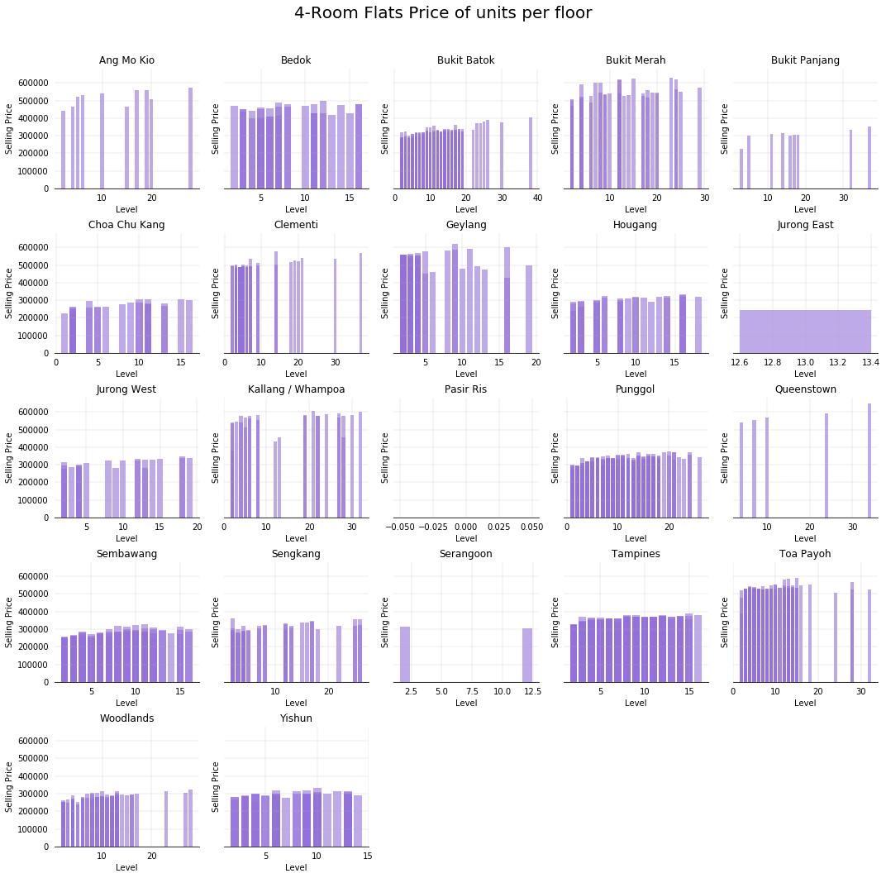
Selling Price vs Level for 4-Room Flats
Bar Chart of relationship between Selling Price
and floor level
Notice that there are different colours of purple
Suggests that there are many count of flats
with the same floor. (See 3-D in next slide)
Since this is 2-D, we focus on the highest price
per floor for comparison purposes.
Slight trend that lower floors are cheaper,
but the variation is not significant.
Suggests that floor level is not significant in
allowing one to guess the price of the flat.
Next slide shows the 3rd Dimension which is the
count of number of flat per level
Plot 6a : Bar Char Selling Price VS Level

Slide 17
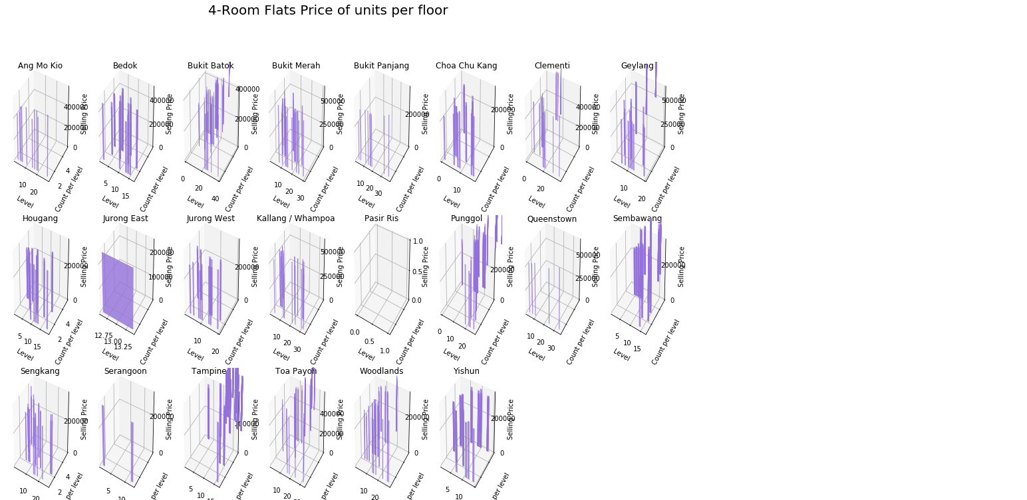
This is the 3-D view of the previous plot. This
demonstrates why the previous plot comes
in different colour variants per bar : Many
counts of flats for each level overlapped
Plot 6a’ : Bar Char Selling Price VS Level VS Count number of times

Slide 18
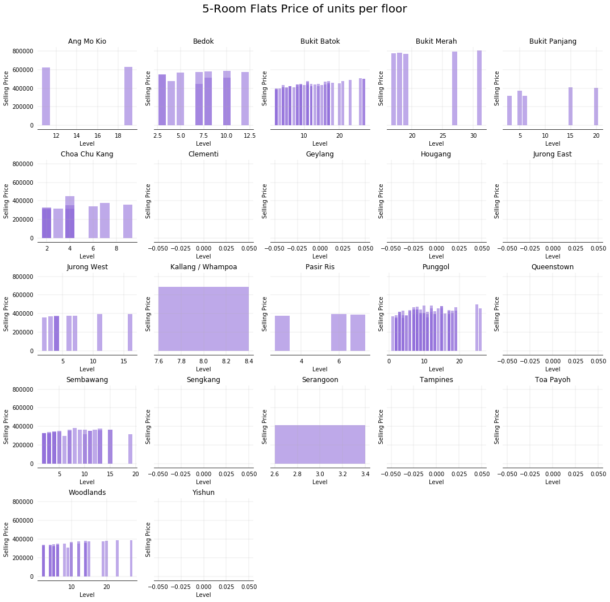
Selling Price vs Level for 5-Room Flats
Some middle level flats prices also lower.
Trend is not assertive
Suggests that floor level is not significant in
allowing one to guess the price of the flat.
Plot 6b : Bar Char Selling Price VS Level

Slide 19
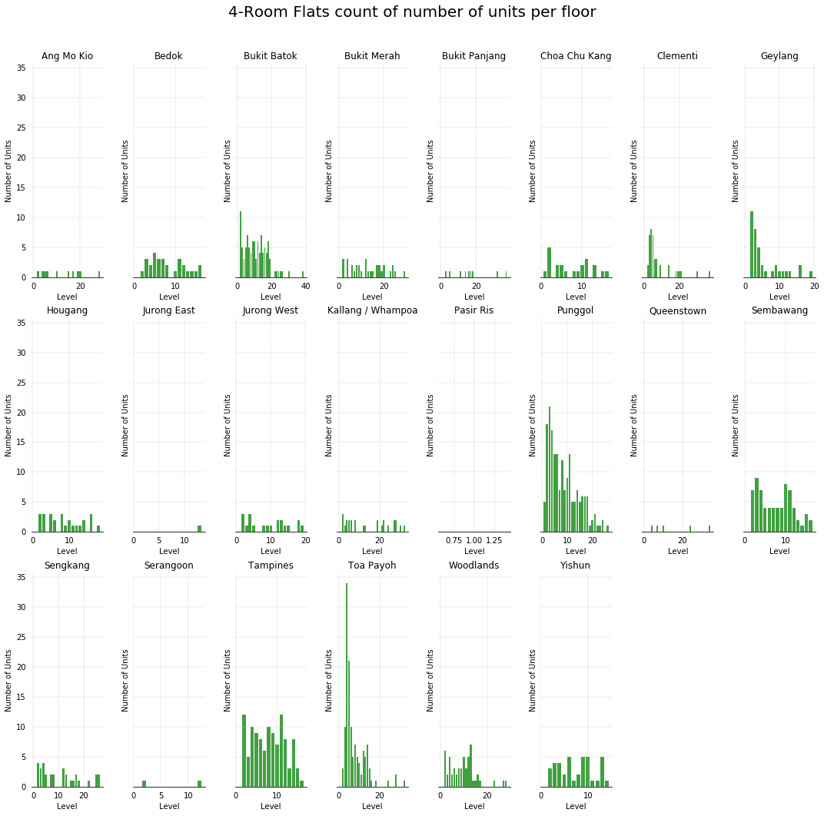
Count of flats per level for 4-Room Flats
Seems to be more number of
lower level flats left for SBF 4-Room
SBF comes from unsold HDB
and flats returned back to govt.
May also lower the couple’s chance
of getting a higher level unit,
which is why this plot is also useful
since SBF also goes by balloting
process and get the queue number.
Plot 7a : Bar Char Selling Price VS Level

Slide 20
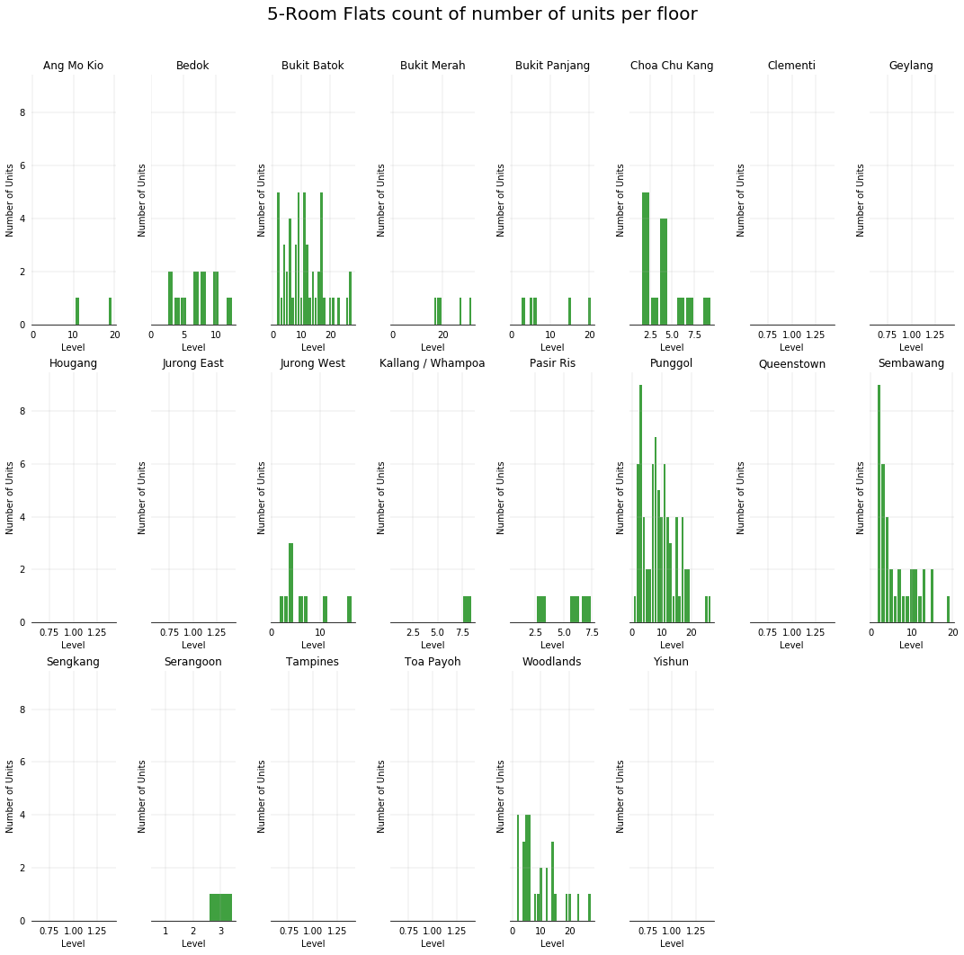
Count of flats per level for 5-Room Flats
Same conclusion for 5-Room
as to the 4-Room flats in previous
slide
Plot 7b : Bar Char Selling Price VS Level

Slide 21
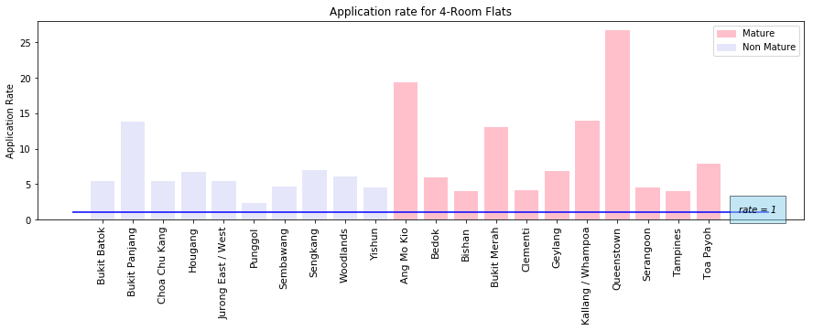
Application rates for Nov 18 SBF for 4-Room FLats
All the towns seems over subscribed
Some couples may not have a chance to
choose the units for the Nov 18 ballot.
Most probable chance to get a flat is Punggol
since its application rate is the lowest.
This chart may lead the young couple to
decide to ballot for Punggol area in future
rounds if this round they failed to get a flat.
If couple wants a mature estate, Tampines is
a good choice as it has lowest allocation rate
among matured estates
Plot 8a : Application rate for Nov 2018 SBF 4-Room Flats

Slide 22
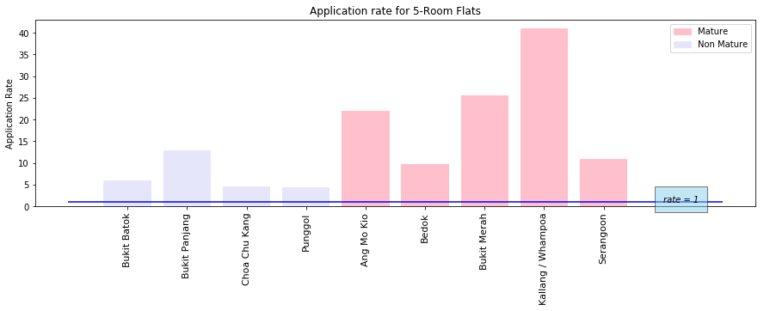
Application rates for Nov 18 SBF for 5-Room Flats
All the towns seems over subscribed
For Non Matured, Punggol and Choa Chu Kang
has low application rate. Good deal!
For Matured, Bedok and Serangoon has lower
application rate. Also good for consideration.
Plot 8b : Application rate for Nov 2018 SBF 4-Room Flats

Slide 23
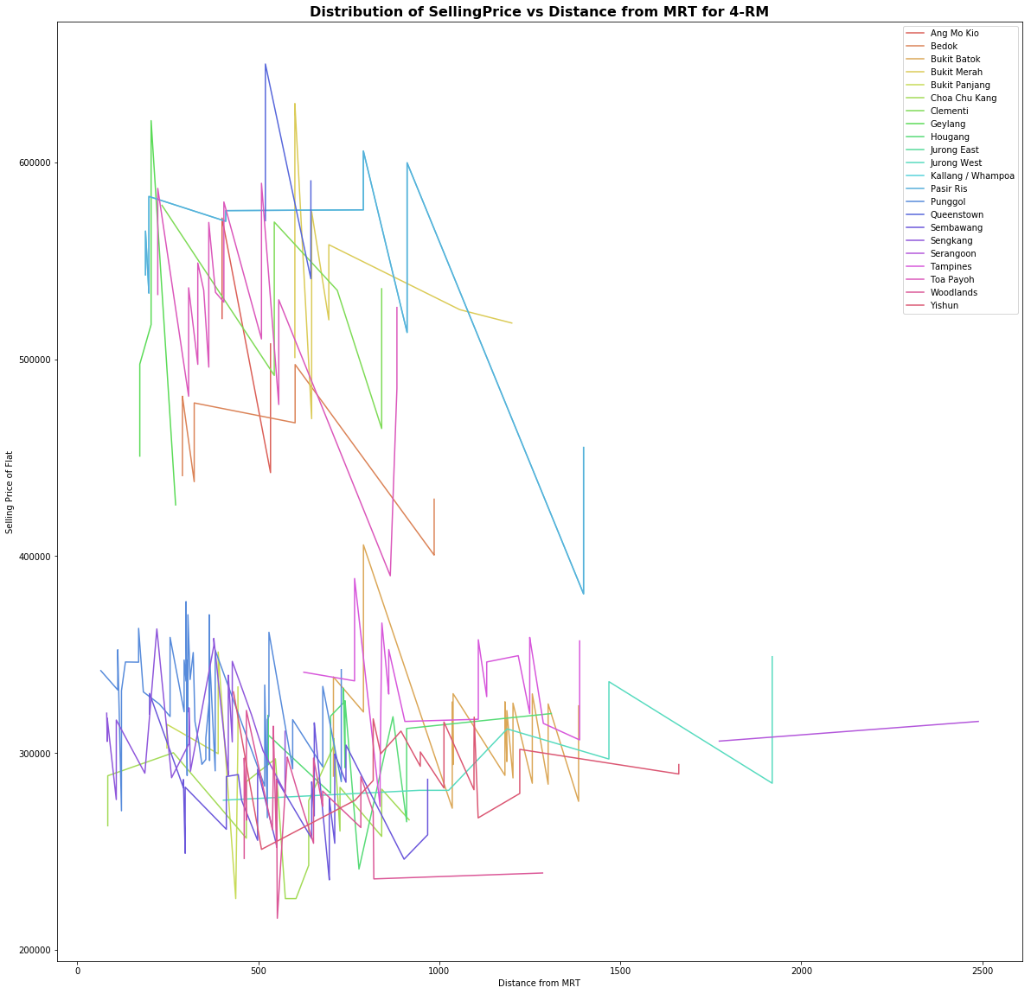
Price VS distance from MRT for 4-Room Flats for NOV 2018 SBF
2 distinct groups appeared on line graph
Hypothesize one is Mature and one is Non
Mature Estates
Given the above hypothesis, no clear trend
between price of flat and distance from
MRT
Couple prefers distance within 2 bustops away
(approx. 1km )so it can still be considered
within “walkable” distance.
“Walkable” Flats include: Punggol, Sengkang,
Queenstown, Choa Chu Kang, Bukit Panjang.
Need to zoom in further to see the trend
town by town whether distance and price
has any trends.
Plot 9a : Line graph of Selling Price vs Nearest Distance from MRT

Slide 24
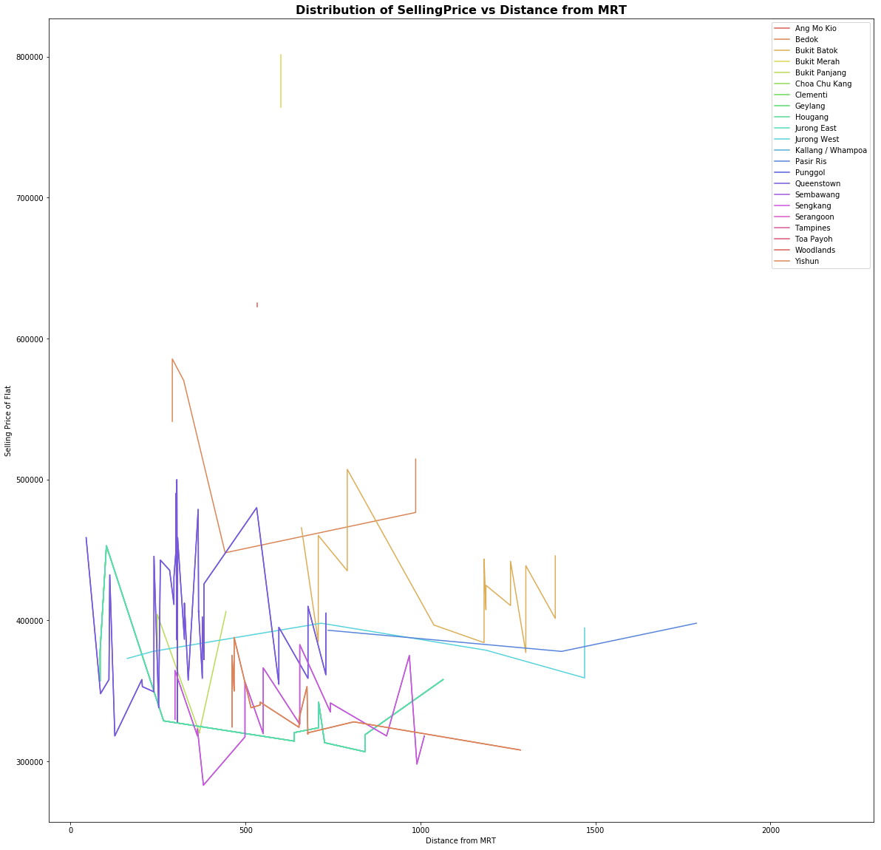
Price VS distance from MRT for 5-Room Flats for NOV 2018 SBF
No distinct groups appeared on line graph
Given the above hypothesis, no clear trend
between price of flat and distance from
MRT
Similar analysis as 4-Room flats
“Walkable” towns includes: Punggol, Sembawang
Plot 9b : Line graph of Selling Price vs Nearest Distance from MRT

Slide 25
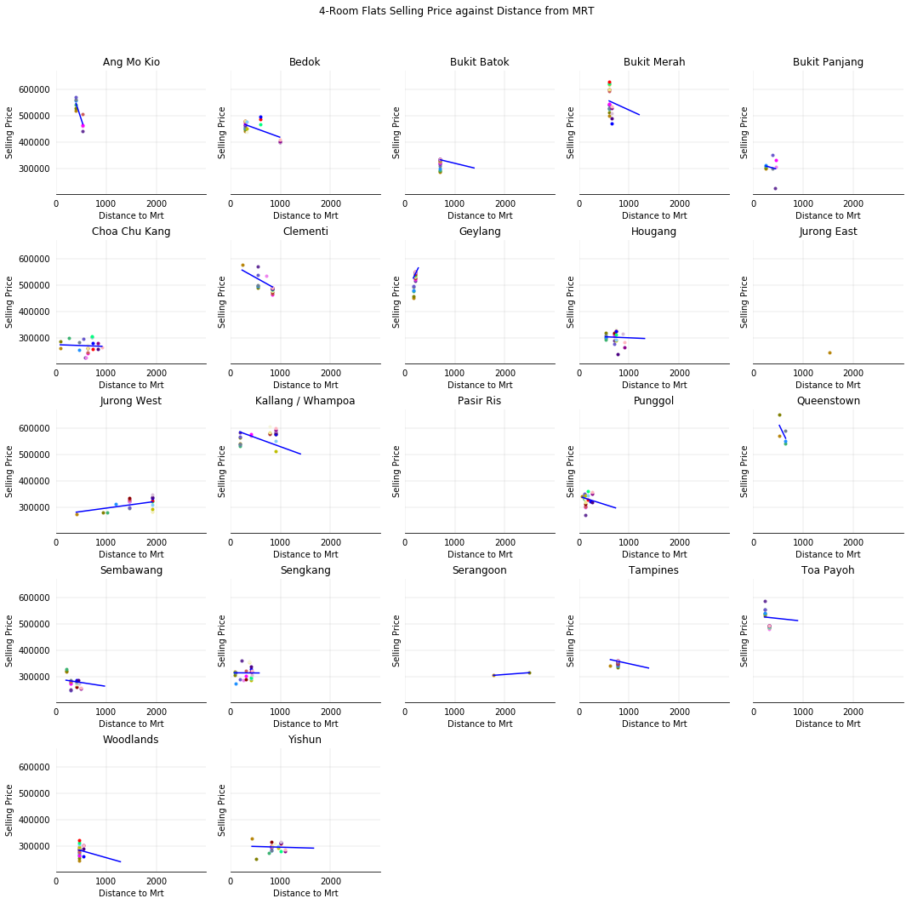
Price VS distance from MRT for 4-Room Flats for NOV 2018 SBF
On closer look at each town analysis
Most of the graph showed that distance to MRT
does have a relationship with the price
As distance from MRT is lower, the price of flat
is higher. Vice Versa
Unexpectedly, there are 3 towns with opposite
trend : Geylang, Jurong West, Serangoon
Serangoon can be explained because it has 2 pts
only, so a regression line is not useful.
Geylang the distances are too close to one another,
probably the same block anyway.
We can further analyse the reasons for Jurong West
This may sound too good a deal for the couple,
so they need to know more about what is so
special about this town to be able to make
better purchasing decisions
Plot 10a : Scatterplot and Linear Regression line of Selling Price vs Nearest Distance from MRT

Slide 26
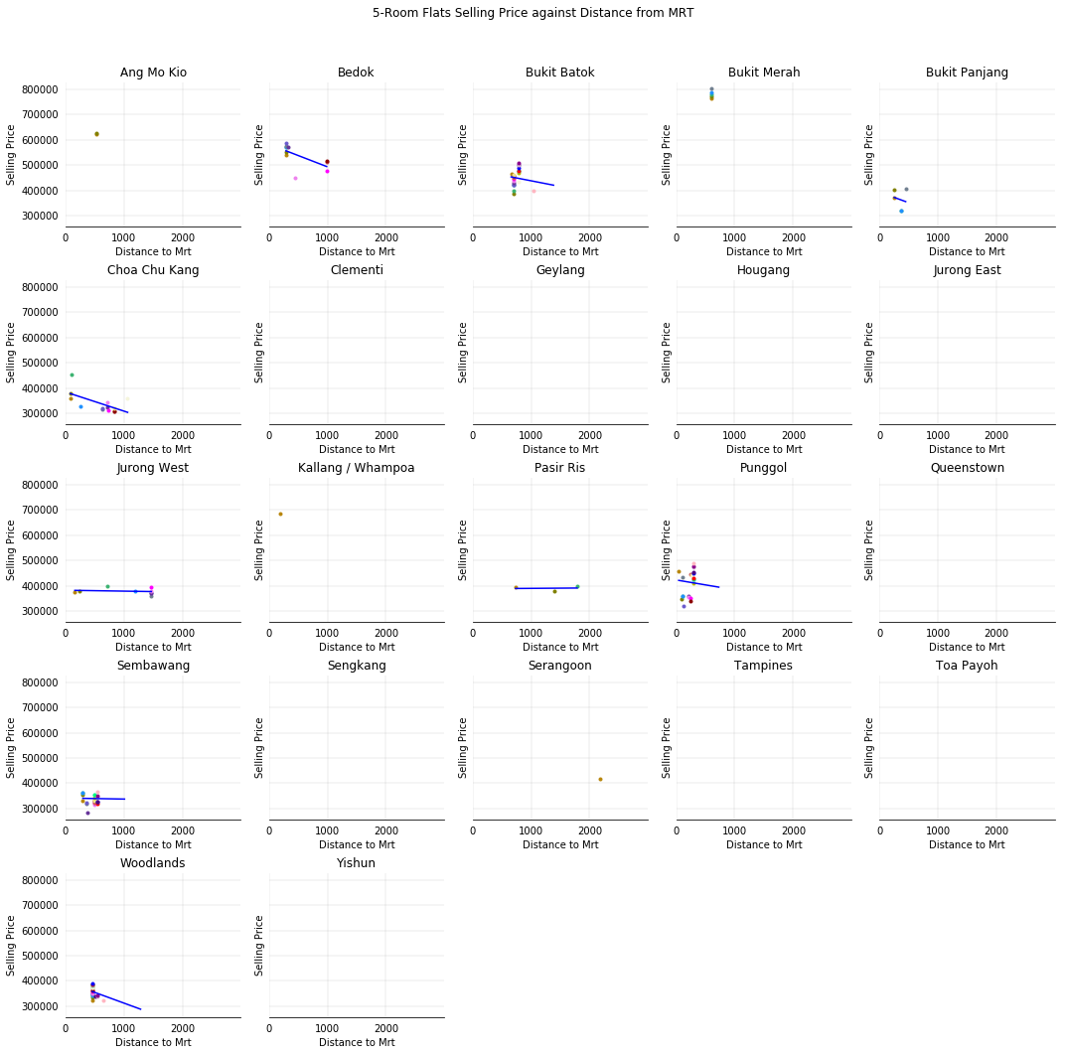
Price VS distance from MRT for 5-Room Flats for NOV 2018 SBF
As distance from MRT is lower, the price of flat
is higher. Vice Versa
Analysis very similar to 4-Room flats
Trend is as expected for all the towns, no
anomalies, so not need for further investigations.
Plot 10b : Scatterplot and Linear Regression line of Selling Price vs Nearest Distance from MRT

Slide 27
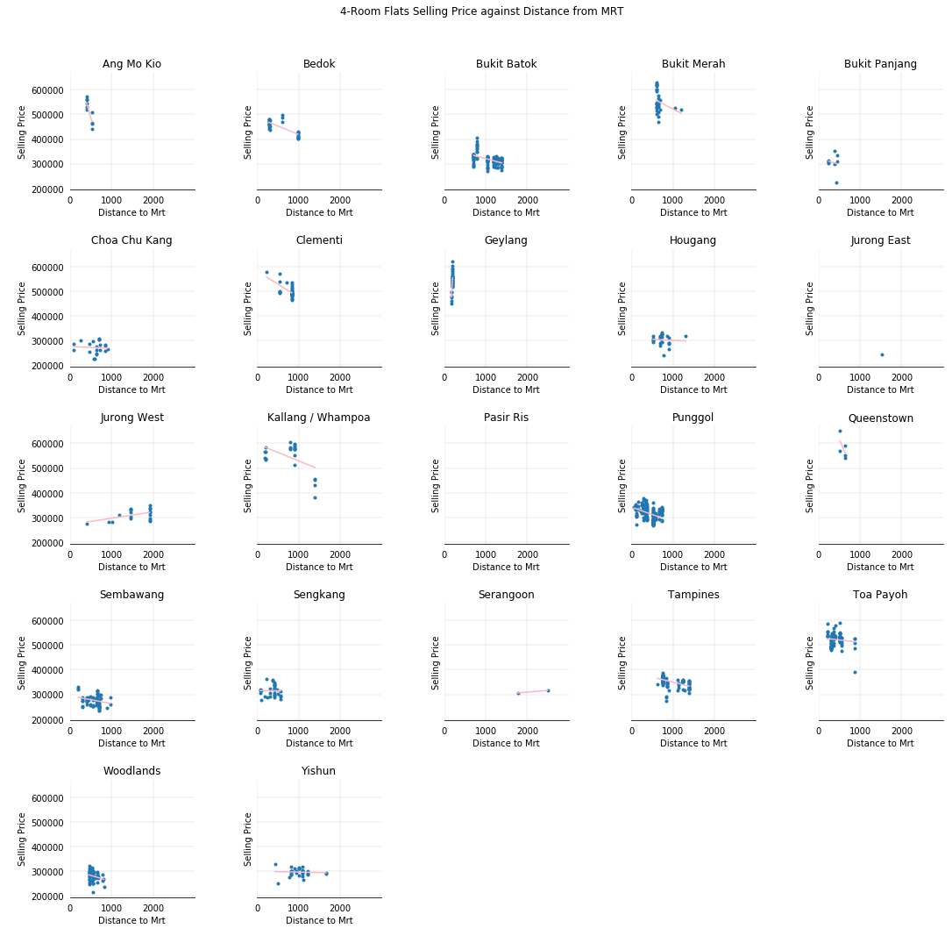
Price VS distance from MRT for 4-Room Flats: zoom In further to special requirements
We hypothesized the trend for Jurong West could
be due to the age of flat, hence we added filters
to the previous scatter plot :
Not Repurchased flat or
Repurchased, but lease not earlier than
1-Nov-2017 (Quite new flat)
For the case of Jurong West, it seems that
these flats still follow the unrealistic trend of
price increasing when distance from Mrt
also increases. (the rest can be unimportant
for our mission)
More investigation needed
Plot 11 : Scatterplot and Linear Regression line of Selling Price vs Nearest Distance from MRT with more filtering

Slide 28
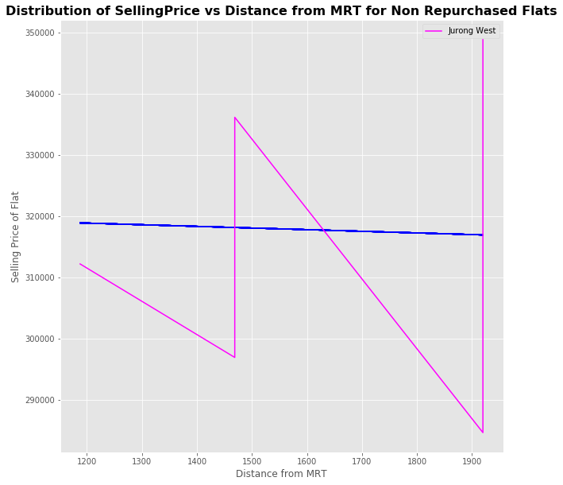
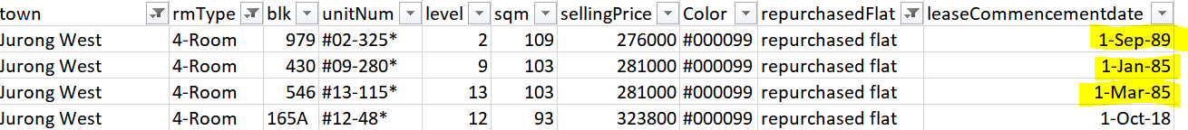
Price VS distance from MRT for 4-Room Flats: zoom Into Jurong West
After removing the “repurchased flats” from the 4-Room
Jurong West flats , we have literally removed all the “OLD”
flats ( includes years :1985,1989)
The trend for Jurong West follows the expected trend again
Hence the reasons for Jurong West flats to be generally cheaper
even though they are nearer to MRT was probably due to the sale
of very old flats.
In essence, unless the couple wants old flats, generally, they are
expected to pay more for flats closer to MRT.
Plot 12 : Scatterplot and Linear Regression line of Selling Price vs Nearest Distance for Jurong West (with Filters)

Slide 29
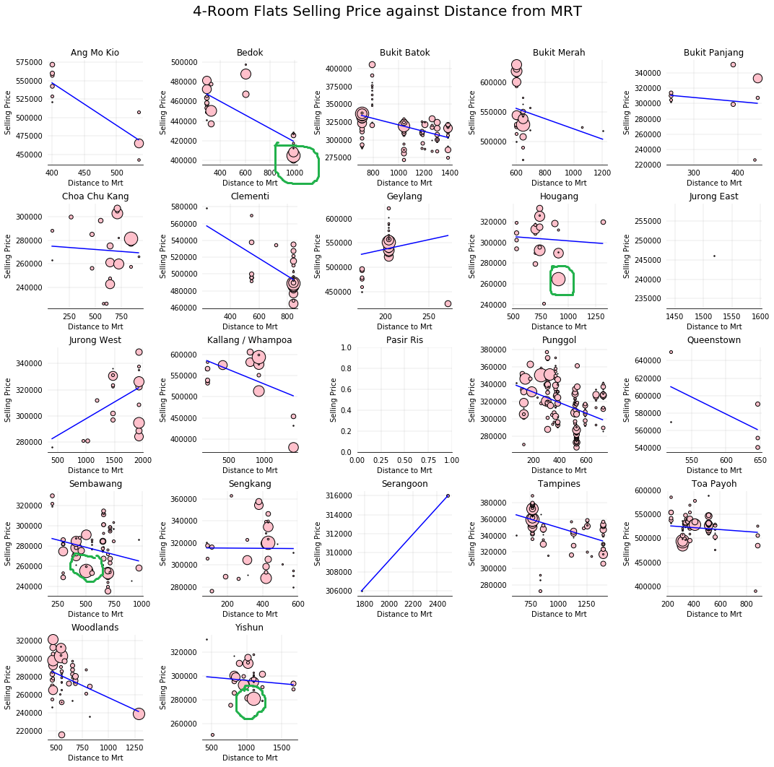
Price VS distance from MRT + vs AREA in SQM for 4-Room Flats for NOV 2018 SBF
We have noticed some good deals (circled in green)
Bedok, Hougang,Sembawang, Yishun
Has prices that are below $300k
Yet the area in sqm is quite big for 4-Rm
Distance from MRT also suit criteria of
approx. 2 bus stops away from MRT,
fulfilling “Walkable” distance criteria.
The couple can look into these towns and
do further analysis on these blocks regarding
factors like “repurchased”, “leasecommencement”,
Maturity of estate and more.
Plot 13a : Bubbleplot of Selling Price vs Dist to MRT vs Area in Sqm

Slide 30
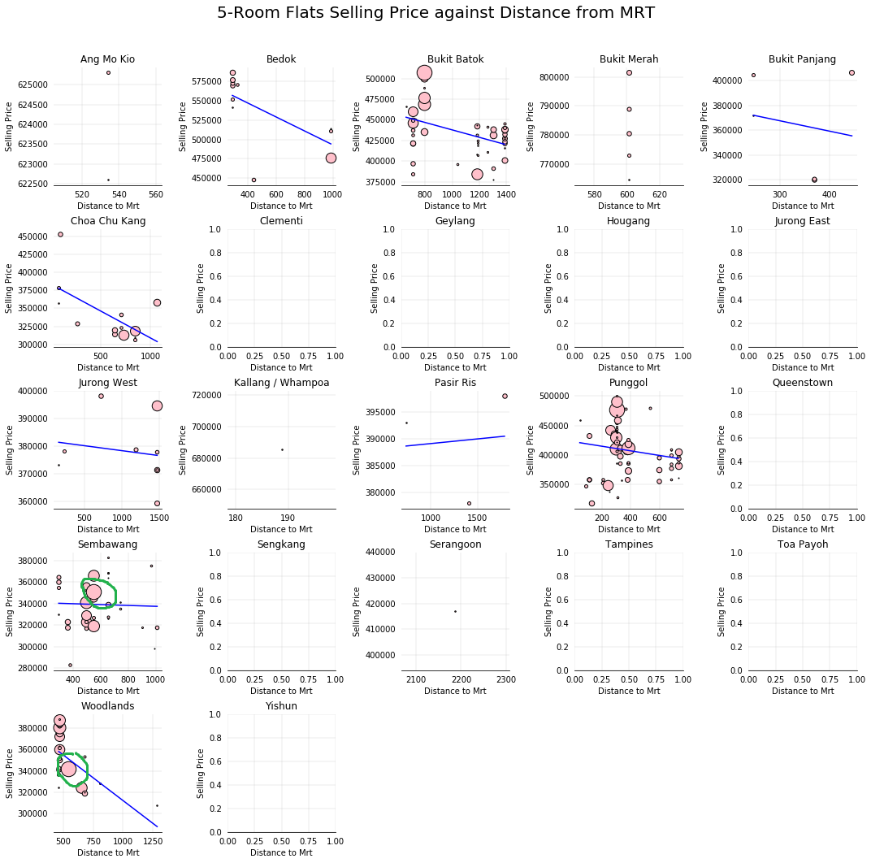
Price VS distance from MRT + vs AREA in SQM for 5-Room Flats for NOV 2018 SBF
We have noticed some good deals (circled in green)
Sembawang , Woodlands
Has prices that are between $300k- $400k
Yet the area in sqm is quite big for 5-Rm
Distance from MRT is below 600m for those
in green circles (about 1 bus stop away)
The couple can look into these towns and
do further analysis on these blocks regarding
factors like “repurchased”, “leasecommencement”,
Maturity of estate and more.
Plot 13b : Bubbleplot of Selling Price vs Dist to MRT vs Area in Sqm

Slide 31
Interactive Plot : Select Distance and Town and display Townmap and blocks available
Note : The initial pop up map after clicking distance was a default map. Proceed after that by selecting the towns you are interested to see.
Output :
Blks that meets
the criteria
2. TownMap
Plot 14 : Interactive plot select dist, town and displays blks available and townmap

Slide 32
Interactive: DisTance from MRT VS Blk By Selecting towns (4 room and 5-rooms)
Knowing the nearest distance to
MRT is not enough.
For one who likes to plan their itinerary,
knowing exactly WHICH MRT is
very important
Helps the couple to plan situations such as
trip time to parents homes and work, etc
Plot 15 : Interactive plot select town , get Distance vs Blk and its resp MRT stations

Slide 33
Other considerations beyond just Nov18 SBF : ReSale flats
Suppose the couple may want the houses very urgently but did not manage to get a good ballot number.
But they have time limitations due to urgency to get married
They can consider resale flats as an alternative.
Let’s consider Q3 2018 Resale flat Median data , since Q3 is the closest data part of the data source it can get to Nov 2018. ( We extract Q3 2018 out of the whole data set which starts from Q2 2007)

Slide 34
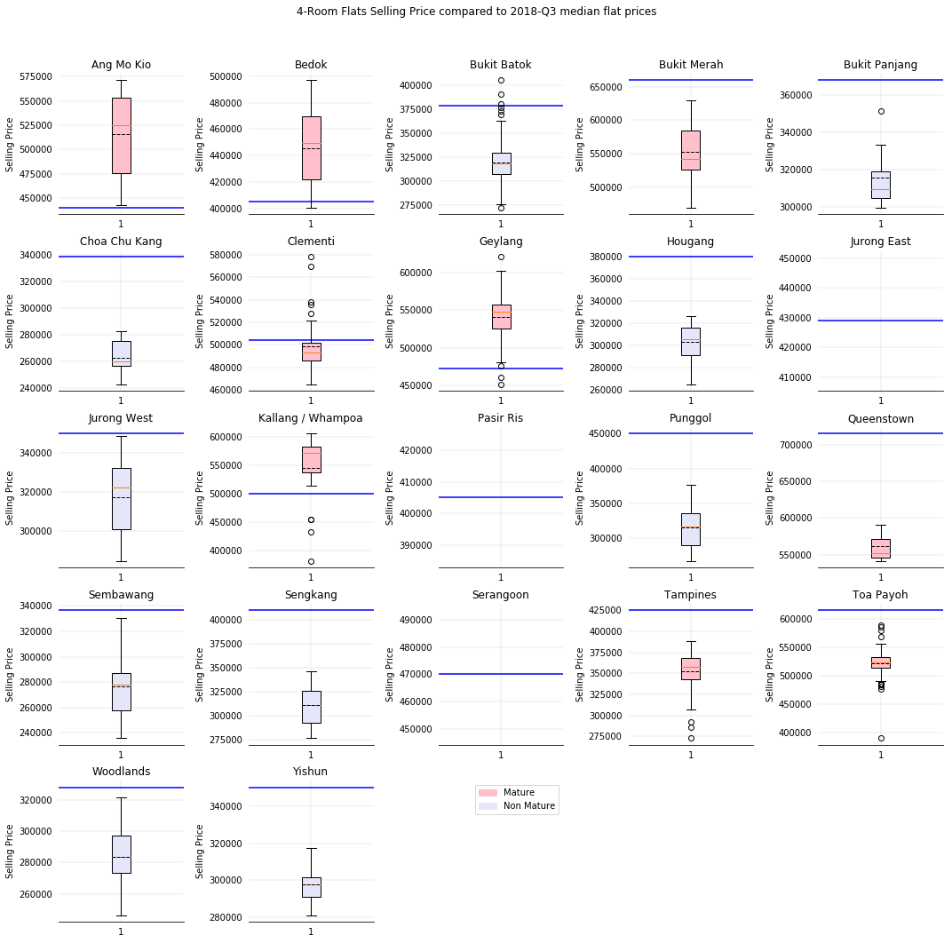
Resale Q3 Median vs boxplot of SBF Nov 18 for 4-Room flat
Blue line represents the median for Q3 2018 median
resale flat prices
By logic, usually resale prices are higher than the
median of SBF.
Those that resale median lower than median of SBF:
Ang Mo Kio, Bedok, Geylang, Kallang/Whampoa.
Need to further investigate why these places resale
is cheaper. Is it possibly a better deal?
Plot 16a : Q3 median resale vs SBF Nov 2018 median

Slide 35
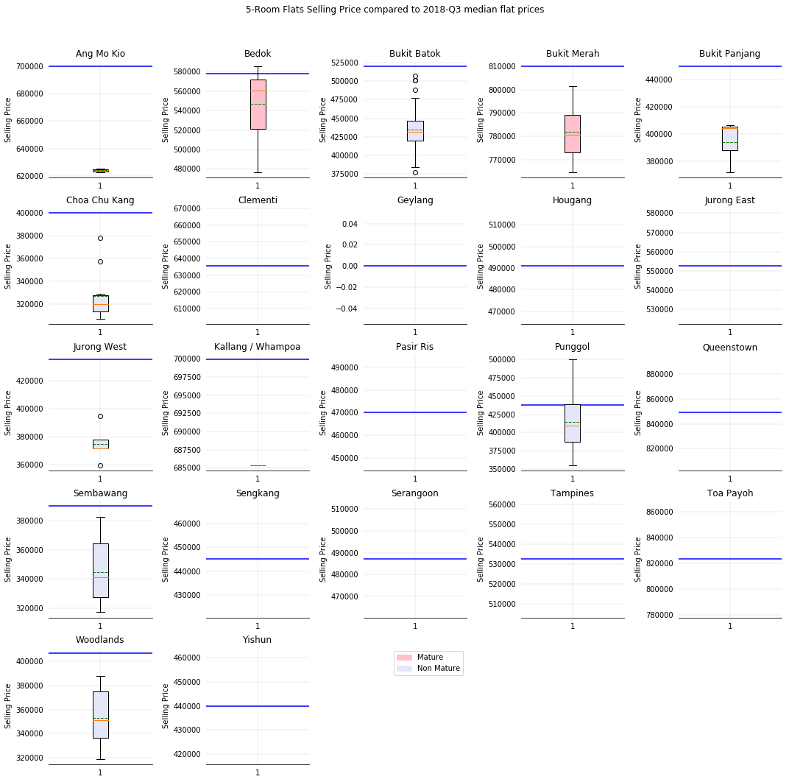
Resale Q3 Median vs boxplot of SBF Nov 18 for 5-Room flat
Analysis same as for 4-Rm flats.
5-Room flats has no anomaly (where resale median
is lower than median of SBF 2018)
Plot 16b : Q3 median resale vs SBF Nov 2018 median

Slide 36
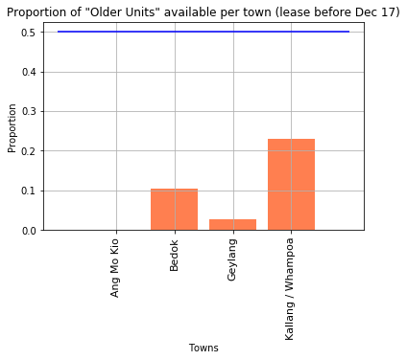
Further Analysis into why the resale median is lower than some of the sbf median
First intuition is that the resale flats
might have been old for the 4 towns
that’s why their median resale is lower than
SBF resale
We set threshold of “older” units as
before Dec 2017
We set threshold for proportion of 50%
to distinguish the town as having majority
old flats.
Since ALL these 4 towns have majority new flats,
age of the flats is not a reason for resale to be lower.
Plot 17a : Proportion of towns with flats considered “old” with threshold 50%

Slide 37
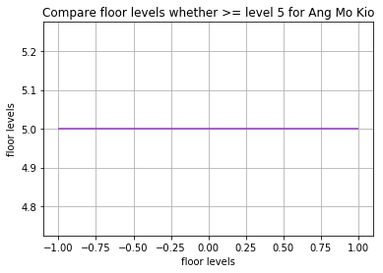
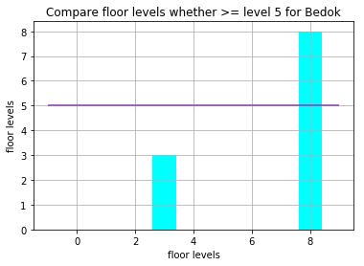
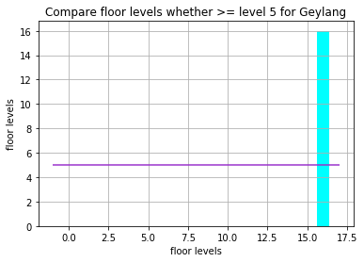
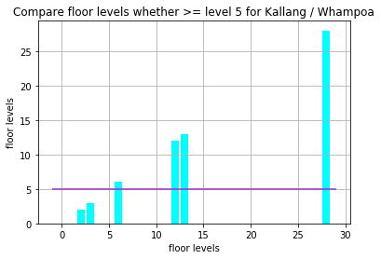
Further Analysis into why the resale median is lower than some of the sbf median (cont’d)
Since age of flat is not a factor, we decided
to see if floor level is a factor
From the charts, it appears that majority of
the flats are above level 5 (below level 5 is
threshold for low level flats according to pricing
of HDB)
Also deduced that floor level is not a factor
Conclude : Could be other possible reasons,
or just that the buyers are lucky to get
cheaper deals from the sellers.
Plot 17b : Proportion of towns with flats considered “old” with threshold 50%

Slide 38
CONCLUsion
According to the analysis, the couple could consider some of the following towns: Woodlands, Sembawang, Punggol, Tampines, Choa Chu Kang and Bedok.
The rest of the intricacies have to leave to the couple to decide whether they want flats closer to their parents house, how close they want and also how big and how cheap the couple needs.
Couple can also not just consider how near they are to the MRT stations, but consider how much travelling time is needed to travel, which is beyond the scope of this project and limitations of the data set.

Slide 39
Summary sheet of where the plots came from
Plot 1 : Plots.ipynb
Plot 2a, 2b : Plots11PriceTOverallTrend.ipynb
Plot 3 : overview_map_interactive.ipynb
Plot 4a : Plot0_Boxplot_Price_Town_OnClick4Rm.ipynb
Plot 4b : Plot0_Boxplot_Price_Town_OnClick5Rm.ipynb
Plot 5a, 5b : Plots3_dist_vs_price_area_vs_maturity_hoverDone.ipynb
Plot 6a, 6b : plots9_2D_priceVsLevel.ipynb
Plot 6a’ : plots9_priceVsLevel.ipynb
Plot 7a,7b : Plots5.NumUnitPerLevel.PerTown.ipynb

Slide 40
Summary sheet of where the plots came from (Cont’d)
Plot 8a, 8b : Plots7_rateOfSubscription.ipynb
Plot 9a, 9b : Plots2SellingPriceDistFrMrt.ipynb
Plot 10a,10b : Plots2SellingPriceDistFrMrt.ipynb
Plot 11: plots13_Scatterplot_nonRepurchased_and_repurchasedNew.ipynb
Plot 12 : Plots2SellingPriceDistFrMrt.ipynb
Plot 13a, 13b : Plots4.Price_Dist_Area.ipynb
Plot 14 : Plots12_InteractiveSelection_distance.ipynb
Plot 15: Plots10_DistToMrt_Vs_Blk_NearestMRT.ipynb
Plot 16a, 16b : plots6_Median_resale_price.ipynb
Plot 17a, 17b: Plots8_DeterminingWhyMaturedResaleLessExp.ipynb

